Slide 1

Building a Knowledge Graph
for
Mike Gallaspy, Ashok Mondal, Kevin Kannappan & Sathish Masilamani
DSE 203: Data Integration & ETL
December 6, 2019

Slide 2
1
Process & Learnings
Agenda
2
Graph
3
Questions

Slide 3
We started by asking relevant questions…
GRAPH

Slide 4
E. | T. | L.
Extract | Transform | Load
Gathered data from a variety of input sources, including: Wikipedia Siccode LinkedIn | Data was blended & structured using different techniques Text Mining From tables From text Entity Resolution | Upload nodes, properties, edges to graph Take different graph entities insert them into Neo4J Ensure graph has proper connectivity
Process

Slide 5
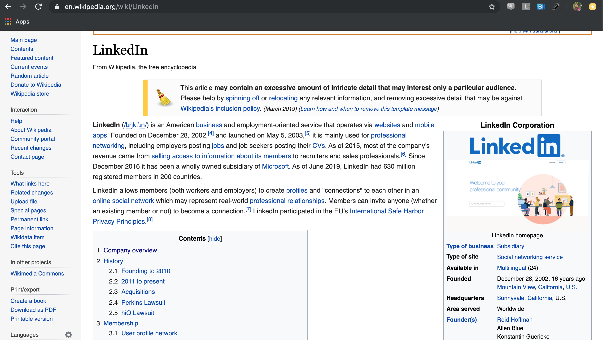
Extract: Wikipedia
Used a combination of:
Scrapy
BeautifulSoup
Why two methods?

Slide 6
Findings: Variability within/between company pages
Company-specific information
“Headlines”
Unstructured text
Info rich
Table format
Common elements, not homogeneous

Slide 7

Automation | Clarity
Index on repeatability | Use contextual analysis
Scrapy used to “crawl” between n different Wikipedia pages Starting on 6-7 pages turned into hundreds after one crawl Advantage: useful with no prior knowledge of problem, repeatable even with changing structure | BeautifulSoup (& requests) used to process C predetermined pages Used XML tags to locate Infobox and first two paragraphs of text Advantage: gather only information that is considered “relevant”, take advantage of data structure for cleaner results
Different approaches

Slide 8
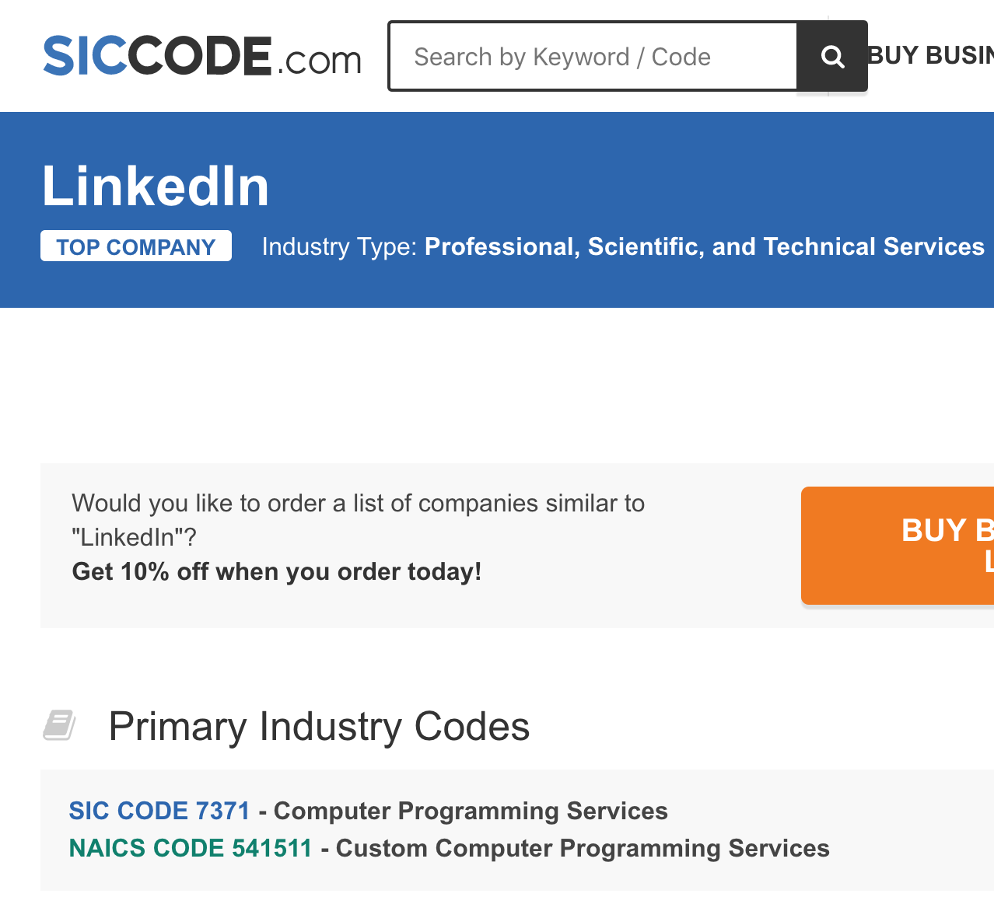
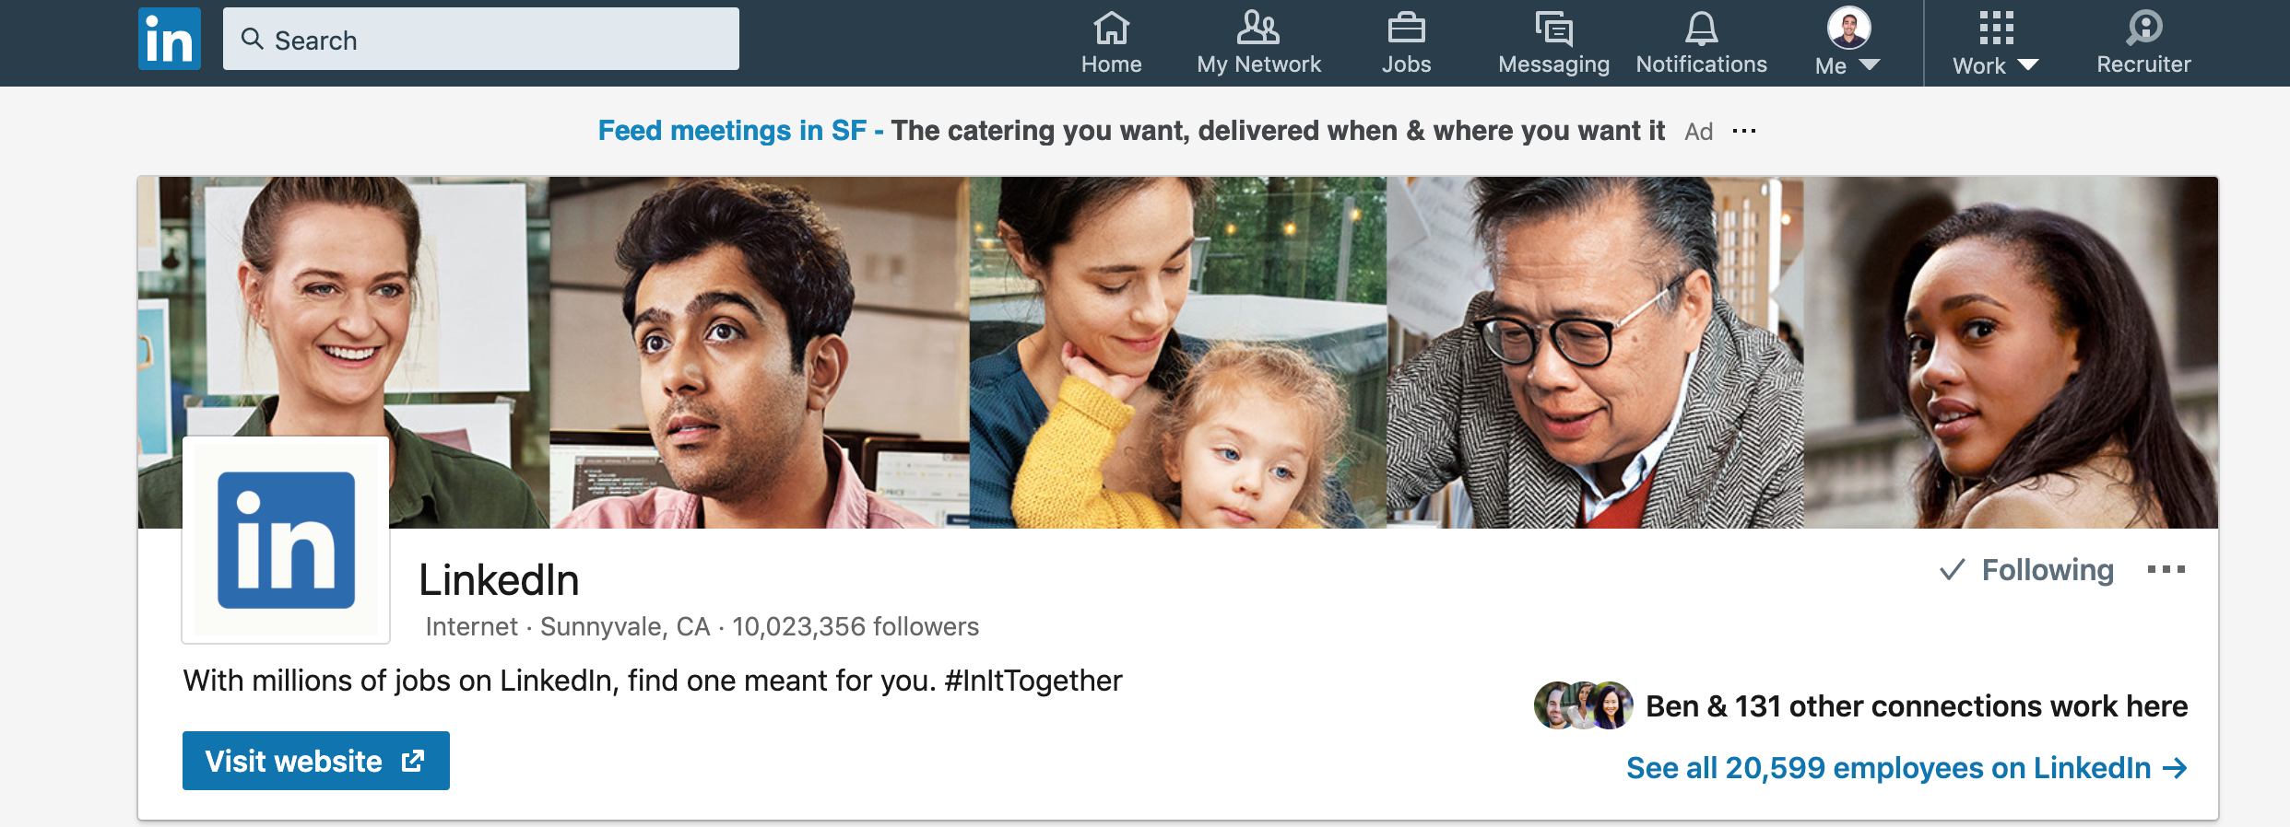
Extract: Other Sources
Used Selenium to gather info from:
Siccode.com
LinkedIn

Slide 9
Siccode: Gather NAICS (industry) code

Slide 10
LinkedIn: Gather accurate headcount measure

Slide 11
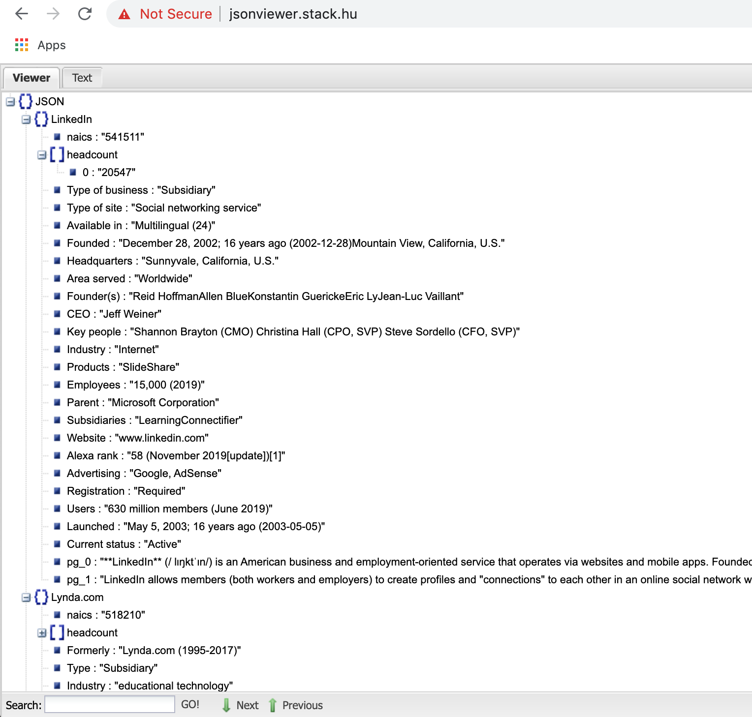
Extract: Results
JSON format allows easy blending of all input sources (and methods) by appending to “key” attributes

Slide 12

Automation | Clarity
Storage & Processing | Difficult to Maintain
Saving the HTML after crawling allowed extraction to be quick However, data storage became problem: hit Git limit < 1K pages Large amounts of between-page variability Learning: determining when to process/store data is critical to scale | Solution was difficult to repeat Between-page variability created data-missingness problems XML tags (& info) change, sometimes very quickly depending on the website Learning: better to go for scale and refine processing techniques later
Learnings: Extract

Slide 13
Transform: Text Mining
Wikipedia data came in two formats: tables and text, both of which required different techniques

Slide 14
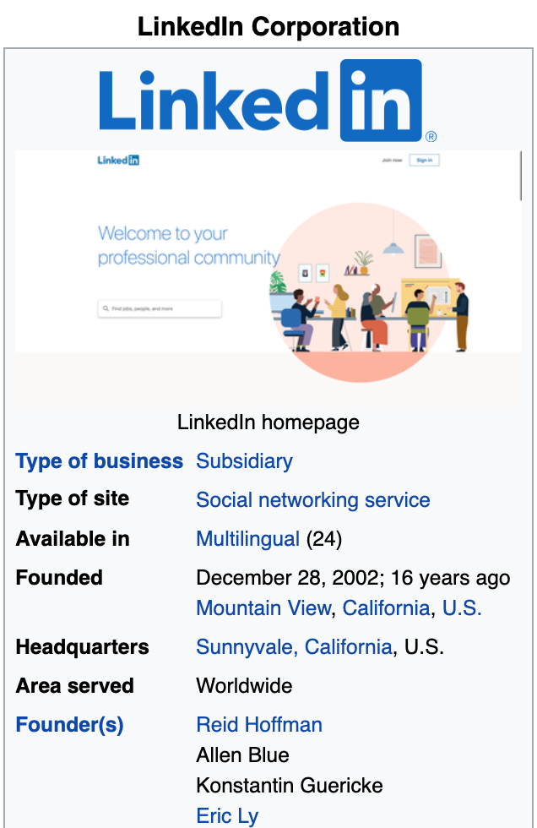
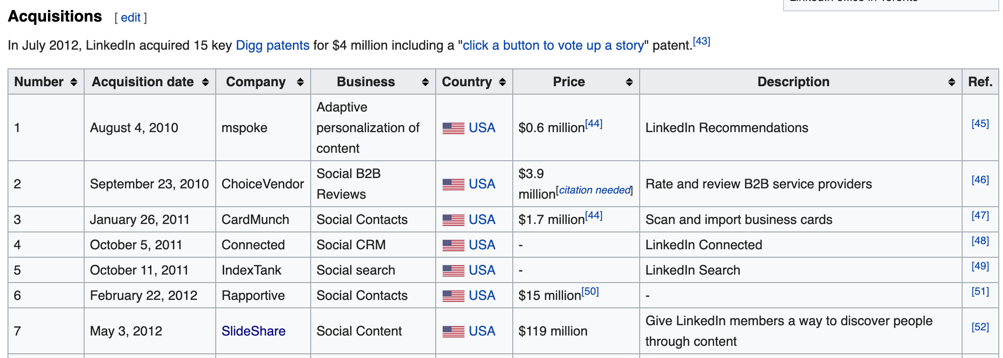
Table Data
After analyzing the Infobox, used the following strategy to transform nodes and edges from the tables:
Assumed Page:Node relationship, where each box contains:
Properties of parent node
Relationships between parent and other nodes
Table structure should be easy to extract information
Used pre-existing knowledge to assign node properties or relationships
Querying the “Infobox” and tables on Wikipedia pages
Notes:
initial strategy was to manually pick a handful of words and decide whether they would represent node properties, or relationships. E.g. if I found the word "Founder" with the value "Reid Hoffman" in the "LinkedIn" infobox I assumed it meant there was a relationship like: (Reid Hoffman)-[Founded]->(LinkedIn) * Similiarly if I found the word "Founded" I would assume it meant a property of the "LinkedIn Node".

Slide 15
Text Data: I
Trying to extract nodes, edges and properties from the unstructured text using NER:
NER tries to identify named entities and their type (commonly Person, Organization, etc.):
Develop a new knowledge graph node for each entity
Leveraged Spacy for ease of use
Used Named Entity Recognition (NER)

Slide 16
Text Data: II
Used Pytex and Rake for Keyword Extraction:
Keywords beyond threshold rank are extracted from each paragraph onn thousands of pages
POS tagging done for each text that contained Stanford NLP words
Verb tags typically represented edge relation
Selective verbs were chosen for transformation
NER recognition to create the Edges and Properties along w/ Parent Node
Using Keyword Extraction and POS Tagging

Slide 17
Table | Text
Expectations vs. Reality | Layers of sophistication
Theoretically easy task, but there were problems – why? Between-page variability in both Structure: Founder vs. Founder(s) vs. Founders Data format: 12M vs. 12 million vs. 12,000,000 Learning: do not overestimate data quality based on a table structure! | 966 pages -> 190,056 entities Created many dupes, standardize by: Included entities having > 1 Blocked by type (e.g. Person to Person) Blocked by length (string length) Fast de-dupe with Jaro-Winkler Performed poorly Context unaware Keyword Extraction = problematic Learning: simple = better. Best performance by picking only commonly observed entities
Learnings: Text Mining

Slide 18
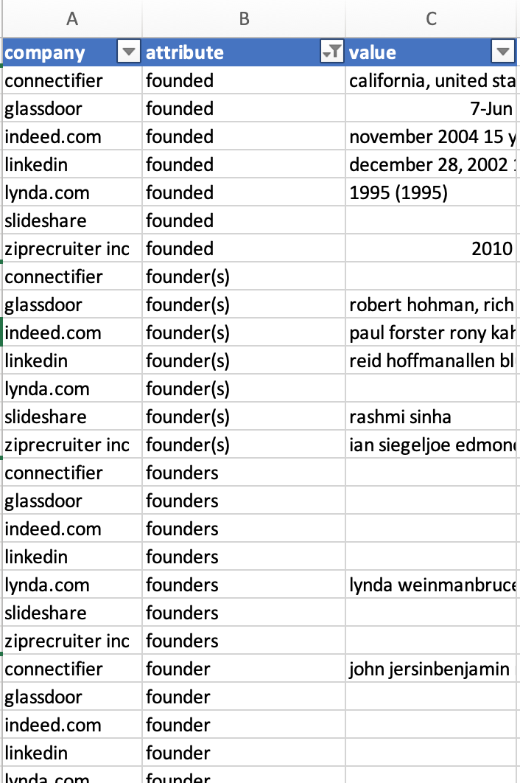
Transform: Deduplication
Problem at hand – similar nodes and edges following table/text data transformation:
Founder
Founder(s)
Founders
Founded
Are they the same?

Slide 19
Deduplication to increase graph clarity
Active Learning & Classifier
“Attribute Blocks”
We used dedupe to label (and correct) attributes that we know to contain the:
Same information
Founder, Founder(s), Founders
Founded, Launched
Different Information
Founder vs. Founded
Model results yielded attribute blocks, where n words were associated with a corresponding block – block was either node or edge.
Learnings: not sure if needed – seemed to be overkill (though effective). Scale with string cleaning & cosine similarity, yet accuracy with current choice.

Slide 20
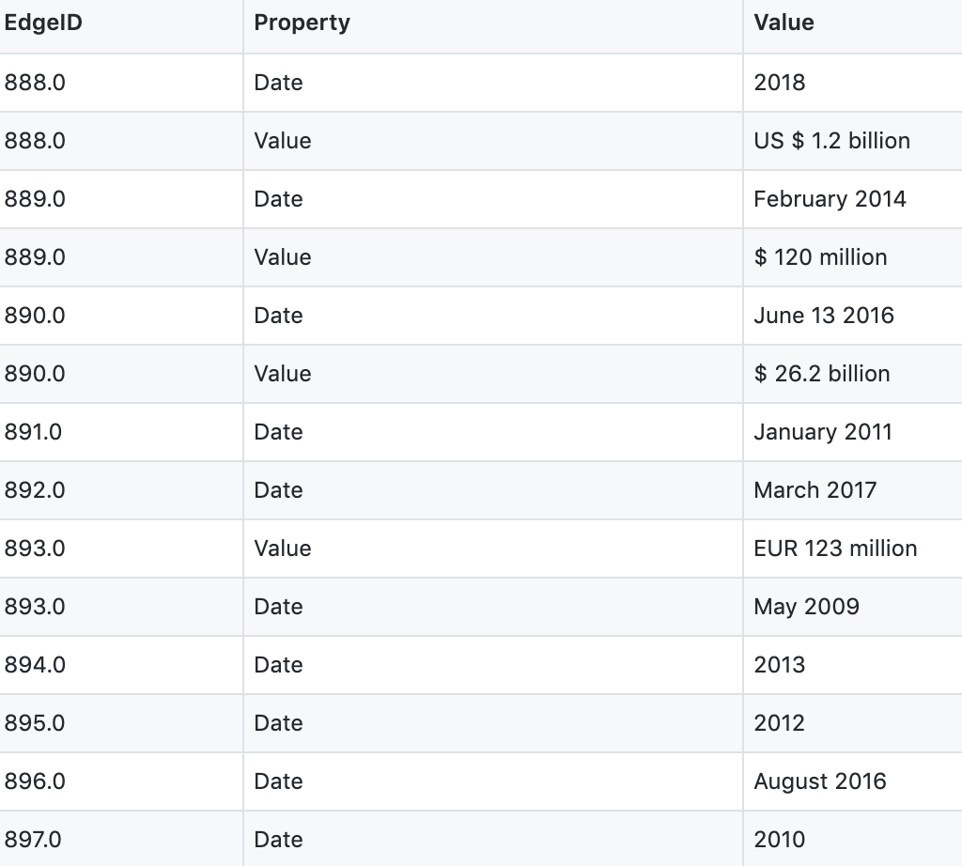
Transform: Results
Results of combined transformations allow for seamless loading into Neo4J

Slide 21
Load: Neo4J Graph
Loading the cleaned nodes, edges, and properties into Neo4J was relatively straightforward. What did we produce?

Slide 22
Our LinkedIn Knowledge Graph
By the numbers
43K/7K
8K
500
Nodes
Unique pieces of information starting from LinkedIn
Edges
Connections or relationships between the nodes
Edge Properties
Types of edges

Slide 23
Histograms by Data-Type
Nodes & Edges properly capture and process information available in Wikipedia

Slide 24
Basic Questions
How can we educate ourselves with our graph?
Find all information directly related to LinkedIn
Find all the companies:
That LinkedIn acquired & competes with
Litigation status

Slide 25
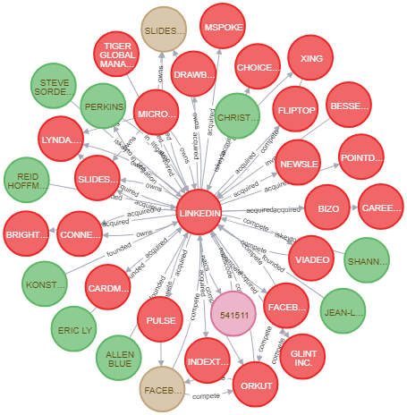
Find all information directly related to LinkedIn
MATCH (n)-[r]-(n1) where n.name =~"(?i)linkedin" return n,n1

Slide 26
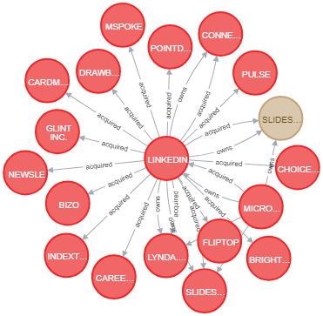
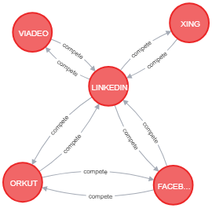
Find all the companies that LinkedIn acquired & competes with
MATCH (n)-[r:acquired]-(n1)
WHERE n.name =~"(?i)linkedin"
RETURN n,n1
MATCH (n)-[r:compete]-(n1)
WHERE n.name =~"(?i)linkedin“
RETURN n,n1

Slide 27
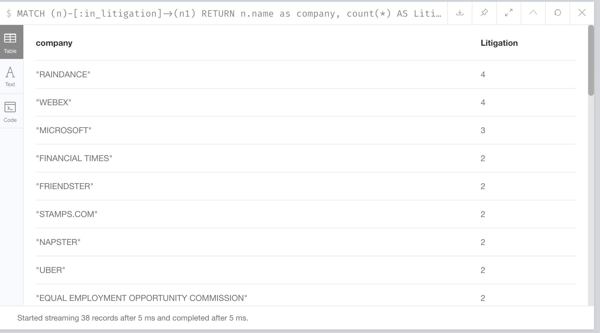
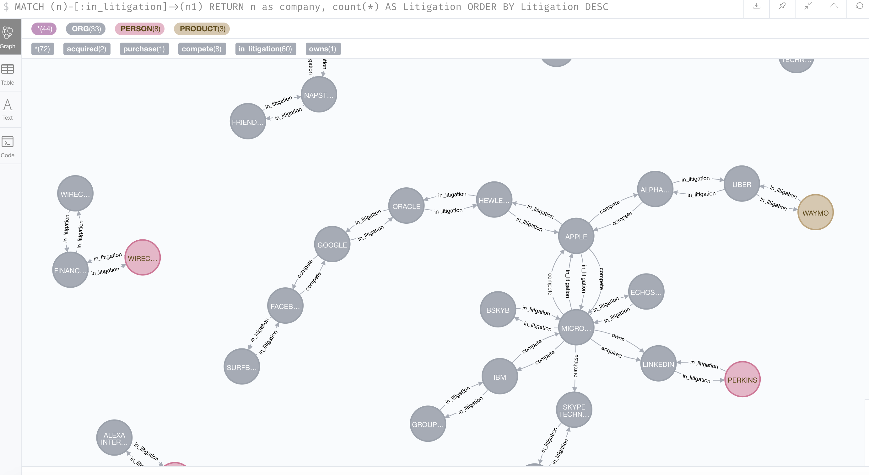
Find all the companies that went to court, and with who
MATCH (n)-[:in_litigation]->(n1)
RETURN n.name as company, count(*) AS Litigation
ORDER BY Litigation DESC

Slide 28
What about something more complex?

Slide 29
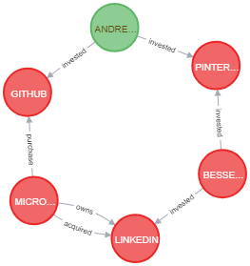
Interesting Queries: Part I
Find the investors who share same trait as the investors of LinkedIn
MATCH (n)<-[r:invested]-(p)-[:invested]->(n1)<-[:invested]-(p1)-[:invested]-(n2)<-[:purchase|acquired]-(n3)
WHERE n.name =~ "(?i)linkedin"
RETURN n,p,n1,p1,n2,n3
Investor Bessel Venture Partners invested in LinkedIN and Pinterest.
Investor Andressen Horowitz has also invested in Pinterest and Github
LinkedIn & Github both got acquired by Microsoft
Shows the Depth of the Graph DB that it aids Marketing Trends & Research

Slide 30
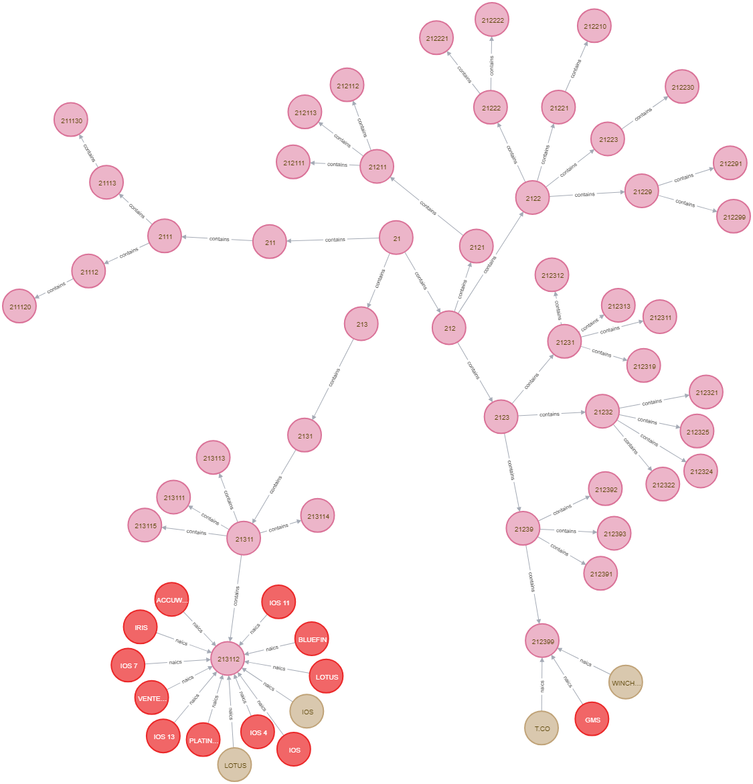
Interesting Queries: Part II
Report the hierarchical path/structure of NAICS
MATCH (n)-[r:naicscode|naics]->(n1)<-[:contains *1..4]-(n2)-[:contains *1..4]-(n3)
RETURN n,r,n1,n2,n3 LIMIT 25
21 -
213,212 – X & Y sector
2131,2123 – XX & YY Industry
21311,21239 – XXX & YYY Business
213112,212399 – Companies/Products associated at this NAICS

Slide 31
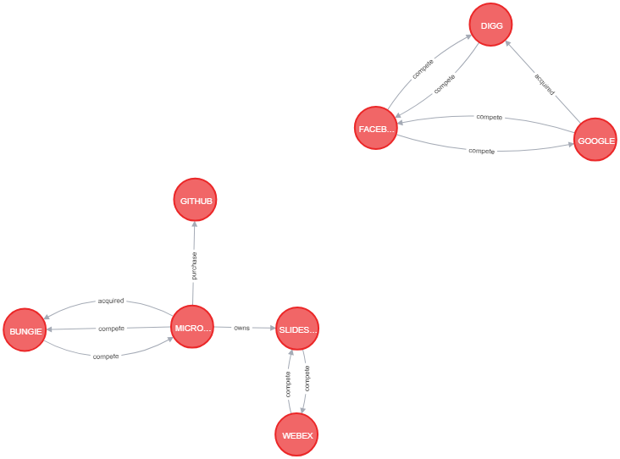
Interesting Queries: Part III
Find the Direct/Indirect competitors that has been acquired in Industry
MATCH (n:ORG)-[r:compete *1..3]-(n1:ORG)
WHERE (n)-[:acquired|purchase *1..3]-(n1)
RETURN n,n1,r
Google acquired DIGG which is an indirect competitor to Google
Microsoft acquires Bungies which was a direct competitor

Slide 32
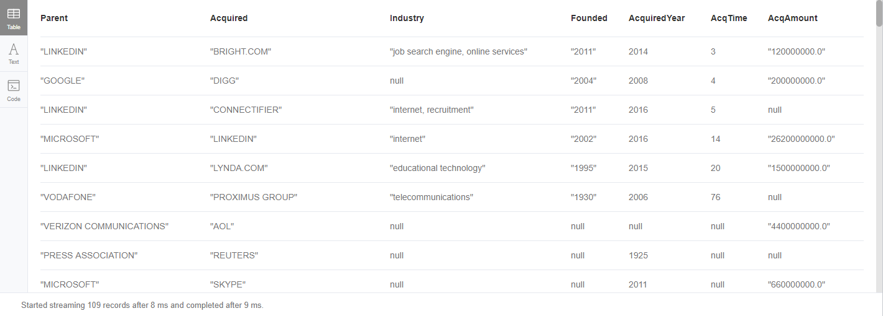
Interesting Queries: Part IV
Find the Type of Business that is consolidating
MATCH (n:ORG)-[r:acquired]->(n1:ORG)
RETURN n.name as Parent , n1.name as Acquired, n1.industry as Industry, n1.foundedYear as Founded, toInteger(r.Date) as AcquiredYear, (toInteger(r.Date)- toInteger(n1.foundedYear)) as AcqTime, r.Value as AcqAmount
ORDER BY AcqTime asc
MATCH (n)<-[r:invested]-(p)-[:invested]->(n1)<-[:invested]-(p1)-[:invested]-(n2)<-[:purchase|acquired]-(n3)
WHERE n.name =~ "(?i)linkedin"
RETURN n,p,n1,p1,n2,n3
Shows the companies /type of Business that got acquired in Nascent stage Vs. Companies in Industries that are stable and mature market

Slide 33
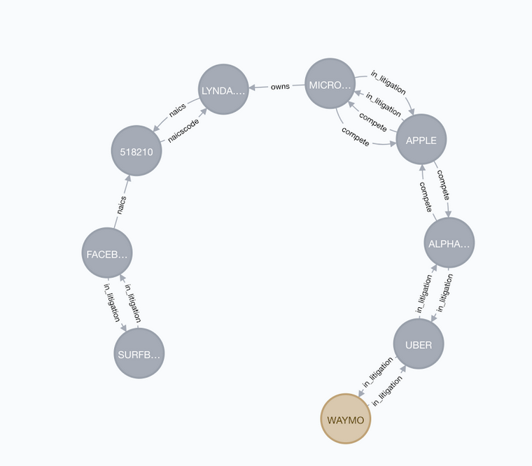
Interesting Queries: Part V
Find unintuitive paths between companies in different industries
MATCH (WAY{ name: 'WAYMO' }),(SURF { name: 'SURFBOOK' }), p = shortestPath((WAY)-[*..10]-(SURF))
WHERE NONE (r IN relationships(p) WHERE type(r)= 'acquired')
RETURN p
Waymo and SURFBOOK are taken as examples and found a unique path (other than acquisition)

Slide 34

Thank you

Slide 35
Github Link
https://github.com/MCGallaspy/dse_203_final_project

